Slide 1

Winged Deer Park Economic Impact Study
Kent Roller, Toby Adebiyi, Adade Yeboah
Kevin Willis, Richard Ojo, Katelyn Williams

Slide 2

Table of Contents
Project Overview and Goals 3-4
Initial Data Sets and Analysis 5-10
Multiplier Effect and Impact Estimation 11-15
Survey Overview 16
RIMS II integration and Moving Forward 17-22

Slide 3
Project Overview
The Johnson City Parks and Recreation department has received funding to move forward with a park expansion.
This park expansion will increase the current field count, up from 5 baseball/softball fields and 3 soccer fields to 9 baseball/softball fields and 6 soccer fields
The existing fields will remain natural turf, but the new fields will be made using artificial turf.
We are tasked with performing an economic impact analysis on this park expansion to determine the degree of benefit obtained by the regional economy as a whole.

Slide 4
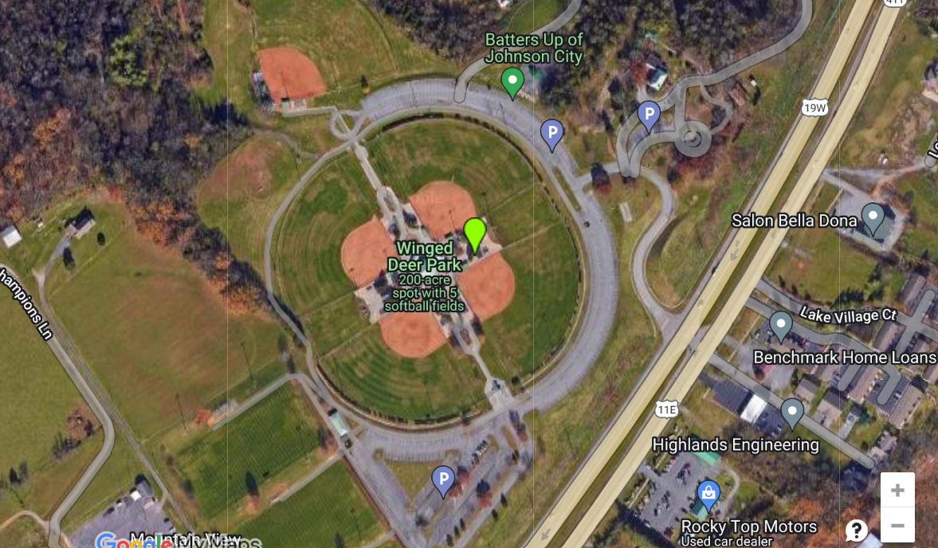
JC Park & Recreation
JC PARK DIGITIZE LAYOUT

Slide 5
Project Goals
Collect all possible data from the source, either JC parks and recreation directly, or other regional government offices that can provide required information.
Create and distribute a survey in an attempt to capture relevant information from regions outside the target region (Washington County in this case).
For additional data not obtained through first two means, we refer to secondary studies to obtain data such as a proportion of non-local visitors.
Create estimates for each sport based on preceding data
Apply multipliers using RIMS II I/O model table for the region

Slide 6
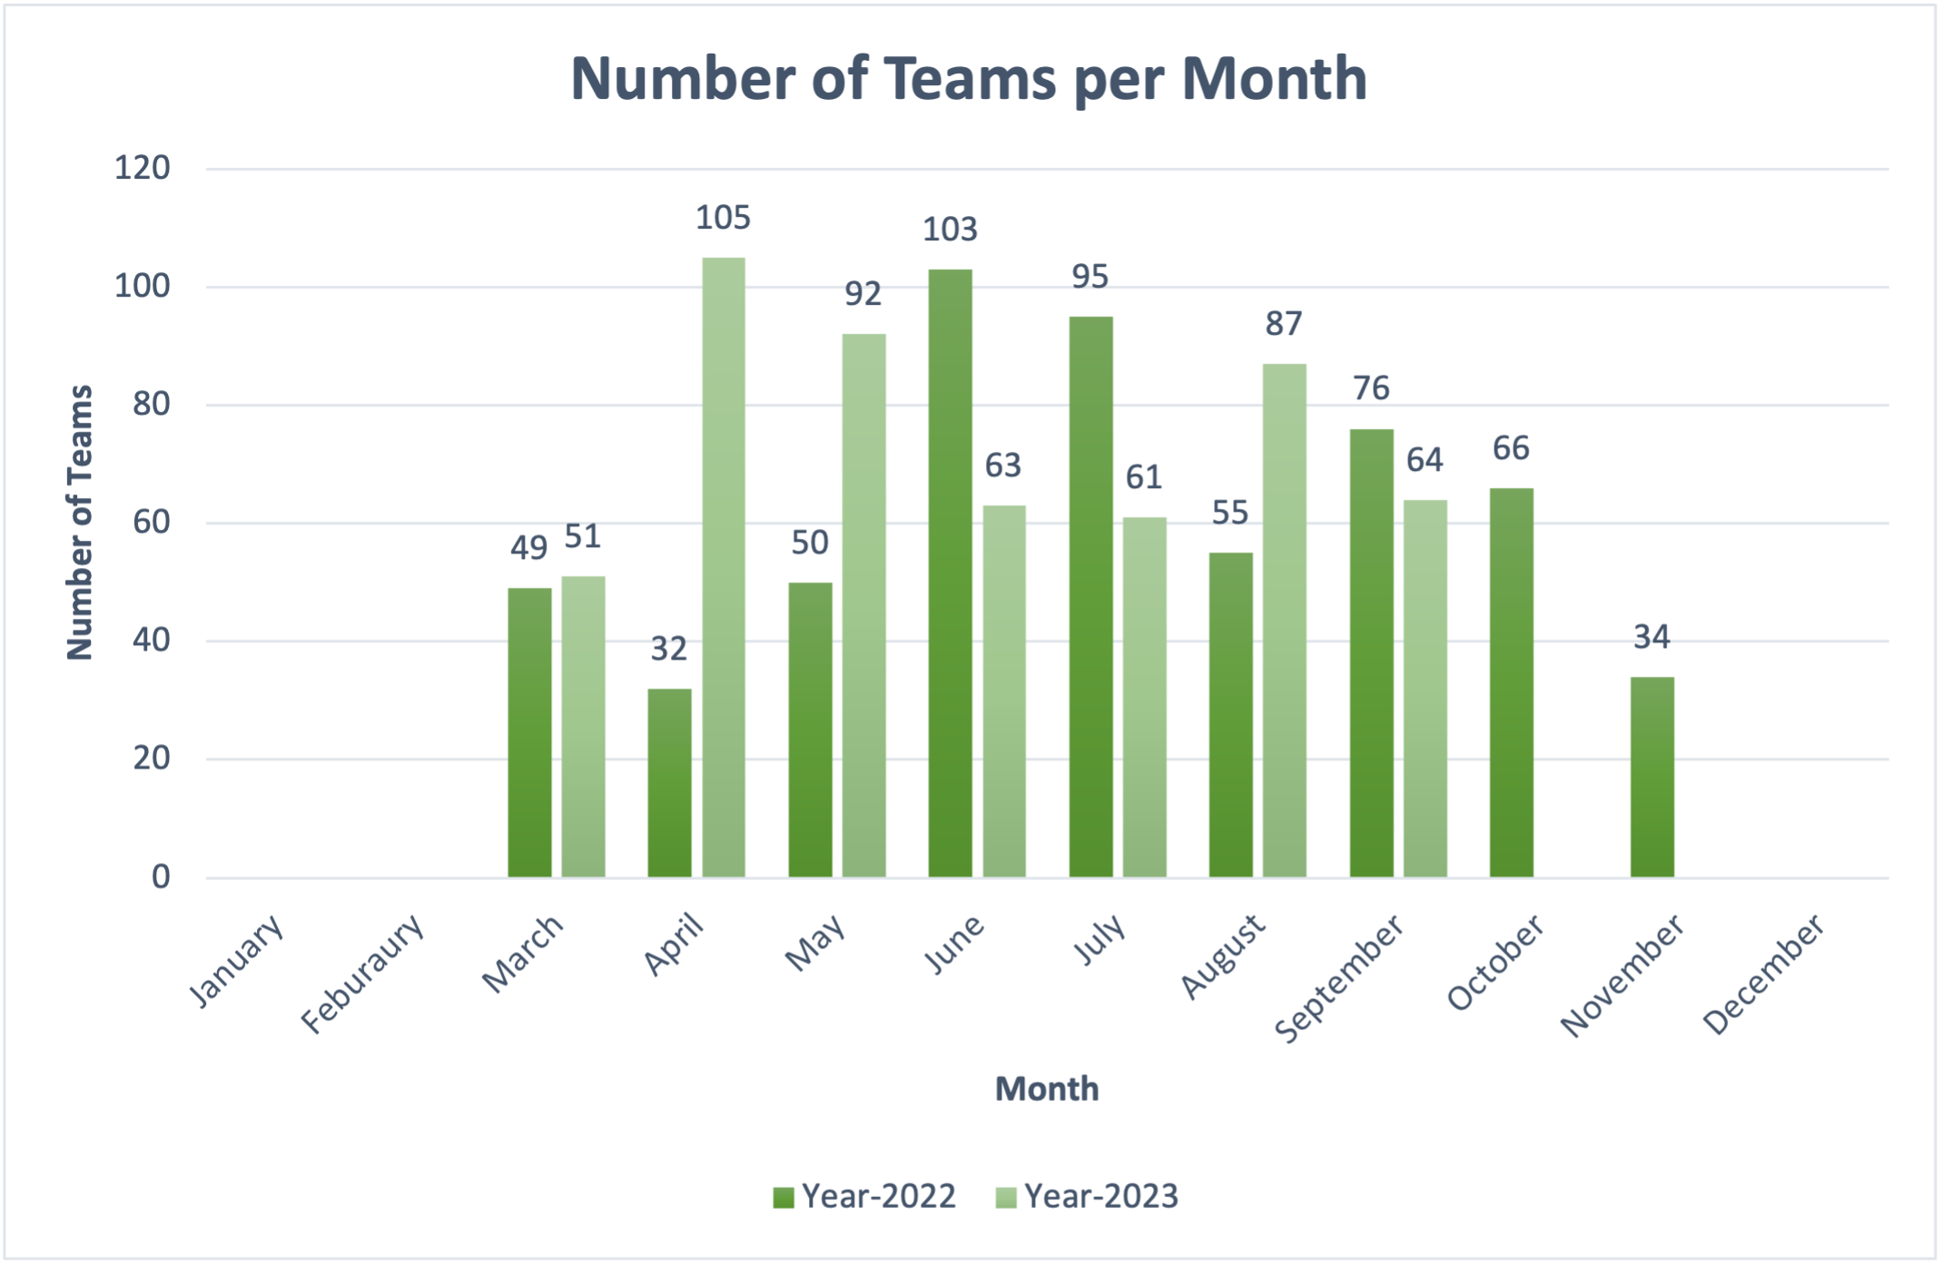
Number of Teams per Month Attending Tournaments
Total Number of Teams in 2022: 560
Total Number of Teams in 2023: 523

Slide 7
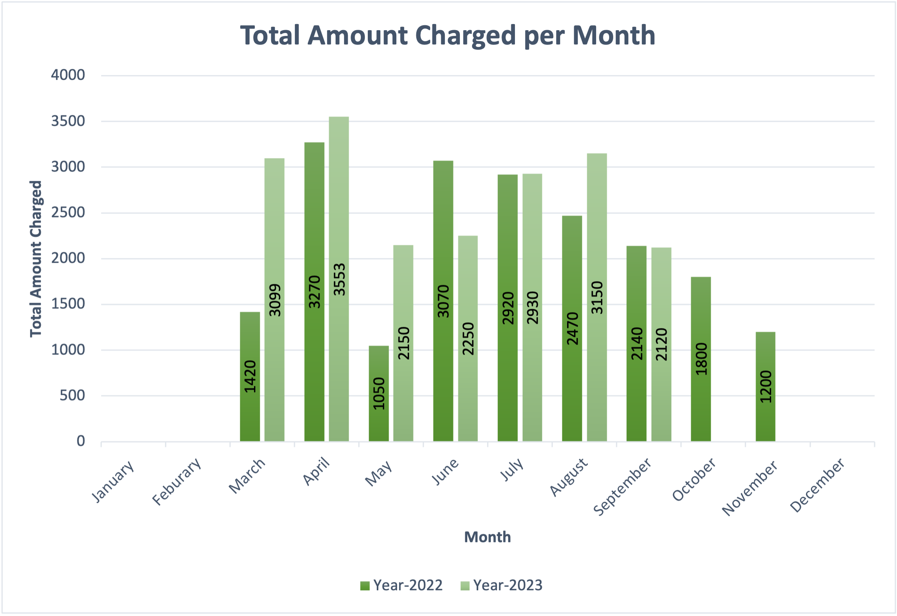
Total Amount Charged to Tournament Directors per Month
Total Amount Charged in 2022: $19,340
Total Amount Charged in 2023: $19,252

Slide 8

USA Softball 18U National Championship July 2023
The USA Softball National Tournament is one of the largest tournaments hosted by Visit JC each year. In 2023, this 5-day event was held at Winged Deer Park for the 18U Girls Class 'A' Fastpitch softball.
National tournaments bring non-locals to the JC area. Visitor spending then impacts the amount of tax revenue the city will in turn receive.
Total Attendees | 1,320
Average Spent per Day | $132
Average Hotel Rate per Night | $118
Total Visitor Spending | $871,200
Sales Tax Revenue | $10,995
Lodging Tax Revenue | $9,499

Slide 9
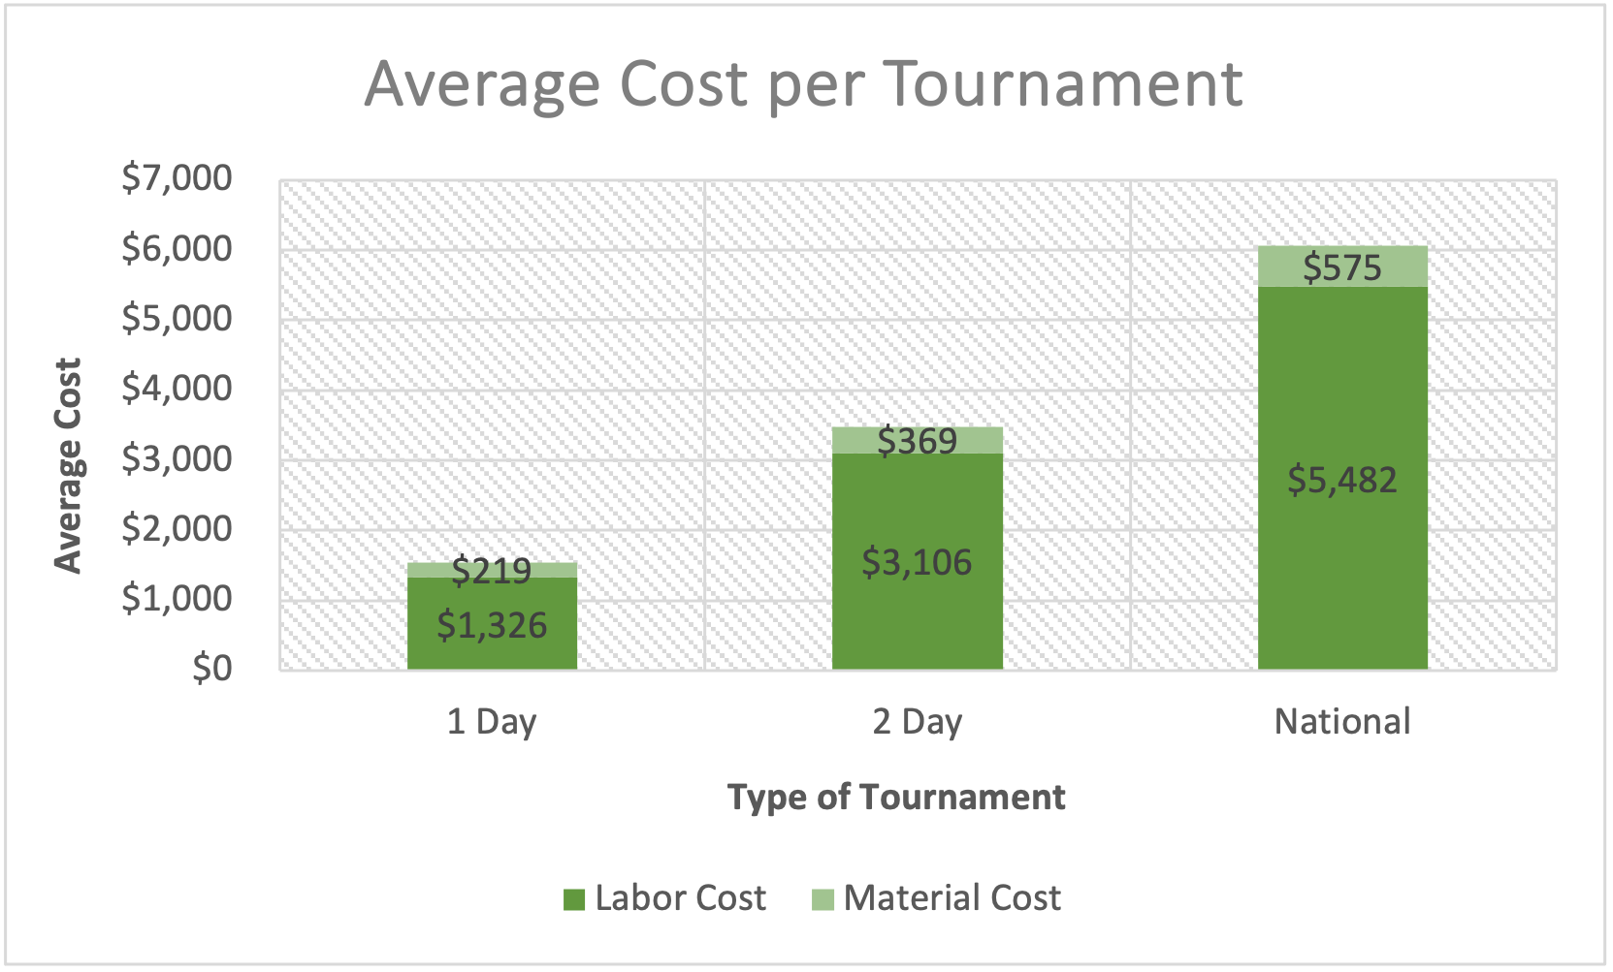
Average Maintenance Cost per Type of Tournament
Total Cost for 1-Day Tournament: $1,545
Total Cost for 2-Day Tournament: $3,475
Total Cost for National Tournament: $6,057

Slide 10
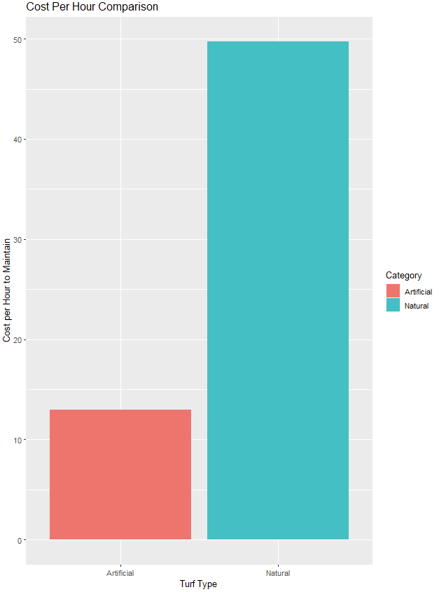
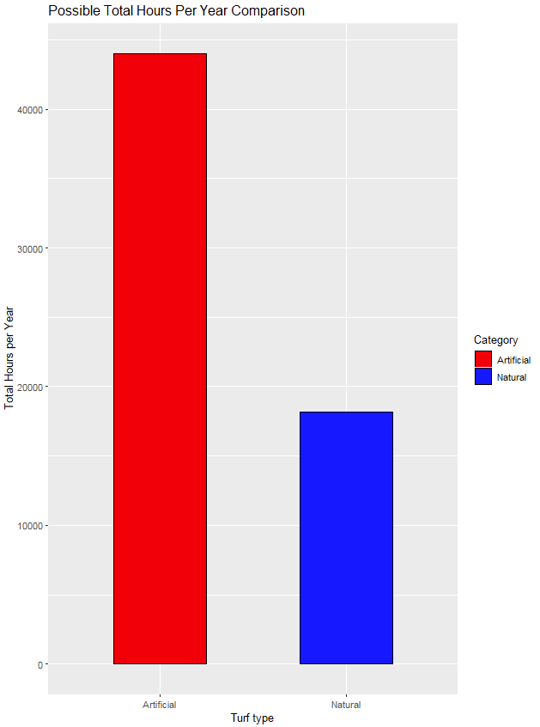
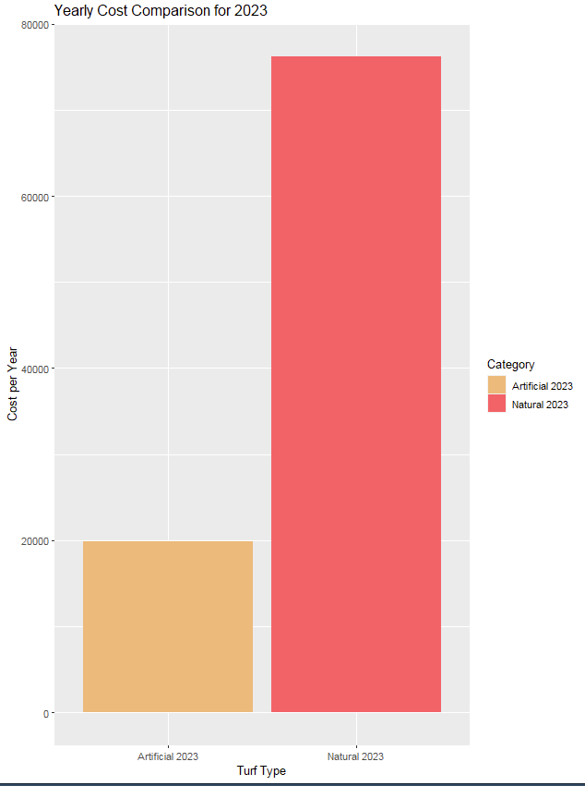
Maintenance Cost Estimates

Slide 11
Gathering Survey Data
Survey Link

Slide 12
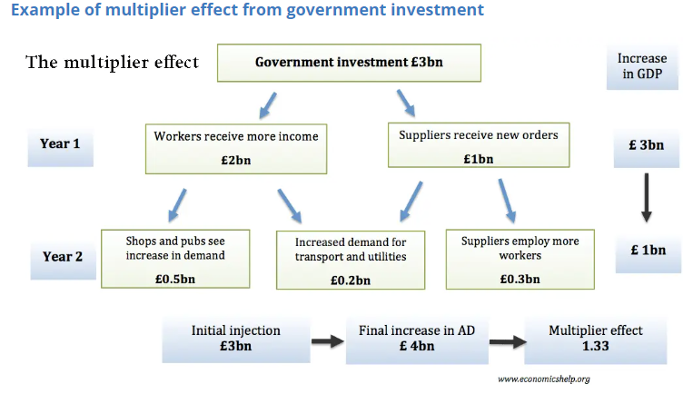
Multiplier Effect

Slide 13
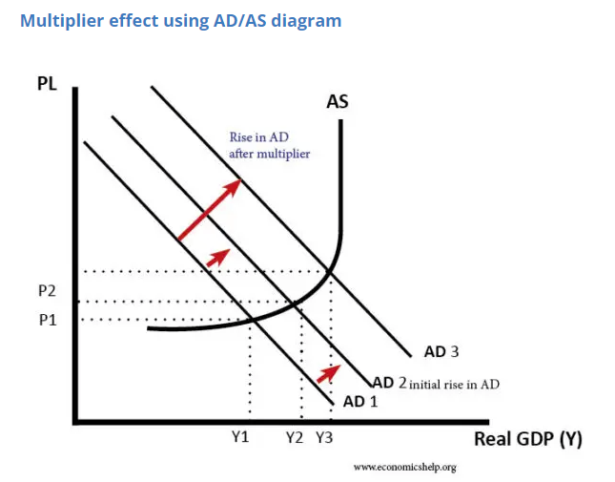
Multiplier Effect Pt2

Slide 14
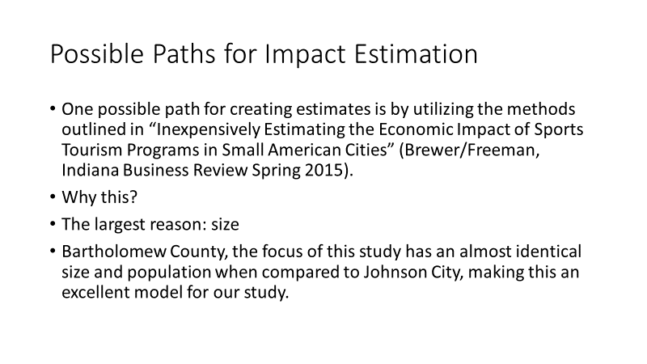
Impact Estimation w/o I/O model

Slide 15
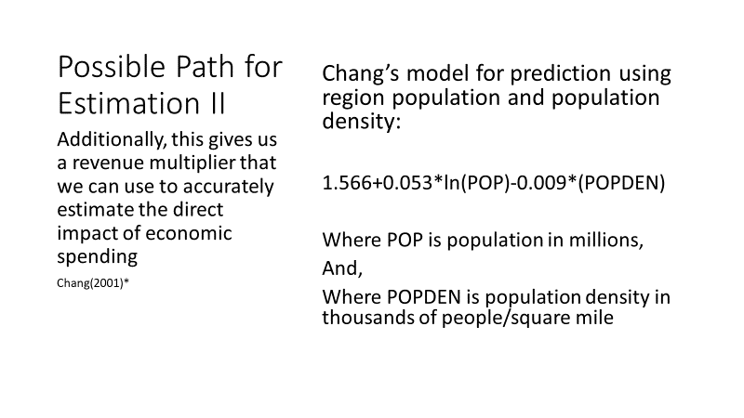
Impact Estimation w/o I/O model II

Slide 16
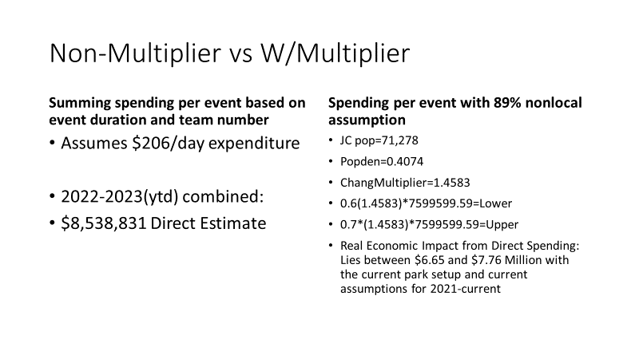
Baseline Estimates from supplied Data

Slide 17
Estimates by Year from supplied Data
2022
2023 YTD
Non-adjusted Estimate
$4.98 million
Adjusted Estimate
$3.95 million lower
$4.61 million upper
Non-adjusted Estimate
$3.17 million
Adjusted Estimate
$2.78 million lower
$3.23 million upper

Slide 18
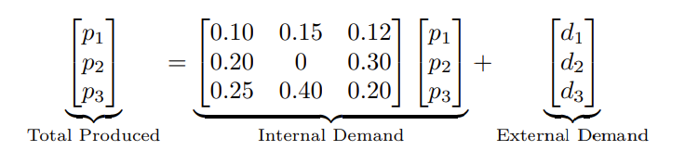
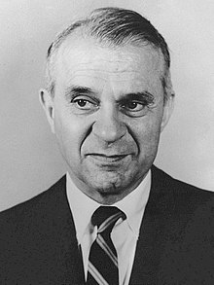
Production Matrix using Input Output model
Input Output Model
The Input Output model is built using a Leontief Matrix, which was developed by Russian-American Economist Wassily Leontief in the 1930s to measure interdependency between industries.

Slide 19
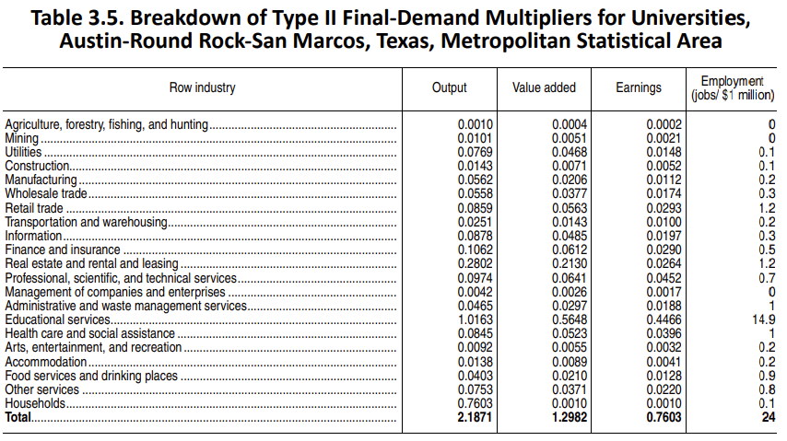
RIMS II table example w/final demand multipliers

Slide 20
Assumptions made when Using I/O model
RIMS II is a backward-linkage model
RIMS II uses Fixed Purchase Patterns
Industry Homogeneity
No Supply Constraints
No Regional Feedback
No Time Dimension

Slide 21
Additional RIMS II information
RIMS II multipliers are only meaningful for analyzing the impact of final demand change in a region. Final demand consist of a number of different types of transactions:
Purchases by consumers outside the region
Investment in new buildings, equipment, and software
Purchases by government
Purchases by households

Slide 22
RIMS II Integration Input-Output Model
Step 1 | Gathering Data
Step 2 | Identify Key Secondary Study
Step 3 | Segment Events
Step 4 | Calculate Travel Party Days
Step 5 | Estimate Total Non-local Parties
Step 6 | Apply Cost of Living Adjustments
Step 7 | Estimate Total Direct Spending
Step 8 | Estimate Total Spending Multiplier
Step 9 | Calculate Estimated Range of Final Demand Impact

Slide 23
Moving Forward
Collect survey data and incorporate it into the data set we already have built
Use both collected data and secondary studies to build a cohesive data set
Once data set is complete begin analysis using RIMS II multipliers as laid out in the manual published by the Bureau of Economic Analysis (BEA).
Produce numbers that correspond with the various economic effects produced by the project
Compile an economic analysis for the park expansion based off of these findings

